Slide 1

High performing teams: it’s not just about the process
©2024 | AGILITY FOR ALL, LLC | PROPRIETARY & CONFIDENTIAL

Slide 2

Who am I? indra aimée books Learn more about me at: https://www.agilityforall.com/indra
25 years focusing on changing how we work to achieve results in public and private sectors. Specializing in:
Onboarding new teams
Revitalizing existing teams
Leadership
Agile Ways of Working
Agile Delivery

Slide 3
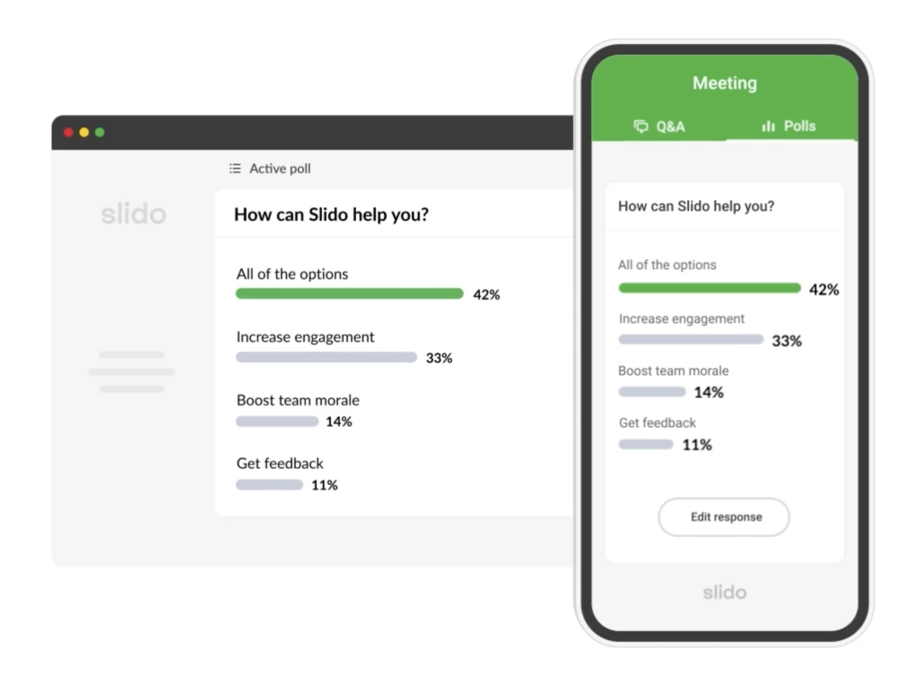

Have a question?
Go to slido.com and enter code #3754551
Ask questions
Upvote other questions

Slide 4
What is agility?
Why does it matter?
What are the results?
©2024 | AGILITY FOR ALL, LLC | PROPRIETARY & CONFIDENTIAL

Slide 5
What is agility?
©2024 | AGILITY FOR ALL, LLC | PROPRIETARY & CONFIDENTIAL

Slide 6
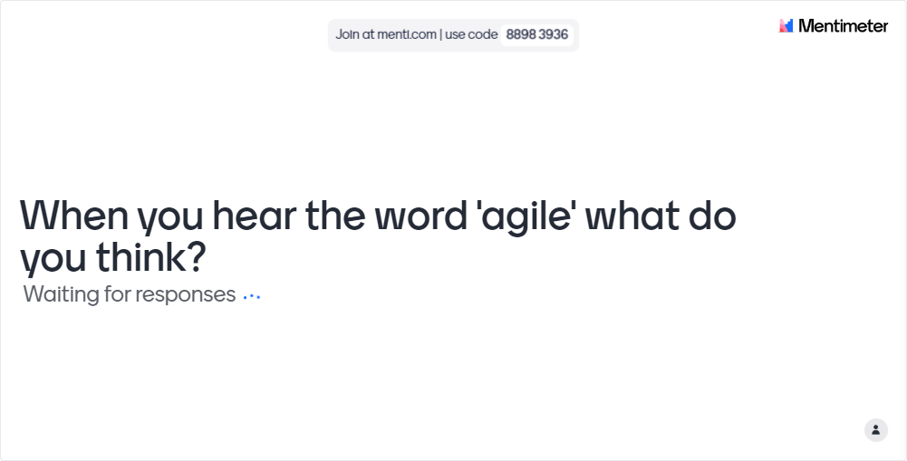
What ARE YOUR THOUGHTS?
©2024 | AGILITY FOR ALL, LLC | PROPRIETARY & CONFIDENTIAL

Slide 7
What people think agility is: Process
Feature Driven
Development (FDD)
SCRUM
Kanban
Lean Software
Development
Dynamic Software Development
Method (DSDM)
Extreme
Programming (XP)
©2024 | AGILITY FOR ALL, LLC | PROPRIETARY & CONFIDENTIAL

Slide 8
Agile framework
adoption

Slide 9
A good process
produces good results.
~Nick Saban

Slide 10


What’s wrong with process?
Nothing! BUT process is just how work is managed.
Focusing on process circumvents the fact that people make up teams; not process.
The key to success is to hire and develop great team members – then empower them to deliver extraordinary results.

Slide 11
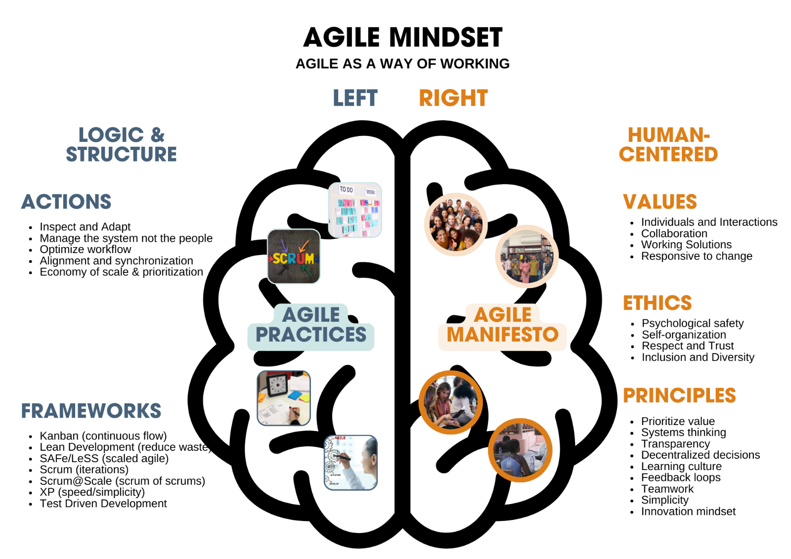
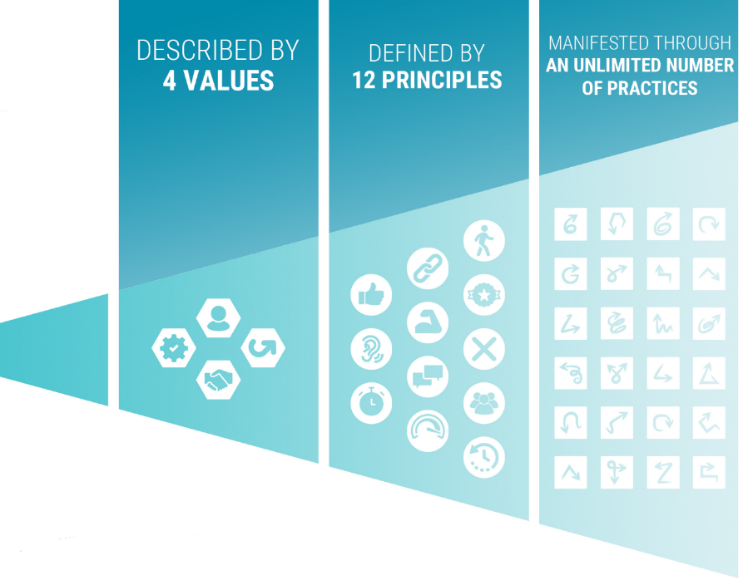
What agility really is
©2024 | AGILITY FOR ALL, LLC | PROPRIETARY & CONFIDENTIAL

Slide 12
Focus: people and interactions
Inclusive and Safe (No more silos)
Mindset
Transparency, Visibility, Flexible
Collaboration, Innovation, Growth
Inspection, Adaption, Improvement
©2024 | AGILITY FOR ALL, LLC | PROPRIETARY & CONFIDENTIAL

Slide 13
Agile maturity – more than process
Tools
More visible
Less powerful
processes
practices
principles
values
Less visible
More powerful
mindset
©2024 | AGILITY FOR ALL, LLC | PROPRIETARY & CONFIDENTIAL

Slide 14



key goals of agile organizations
AVOID
DELAYS
DECREASE RISK
DELIVER VALUE
©2024 | AGILITY FOR ALL, LLC | PROPRIETARY & CONFIDENTIAL

Slide 15
Why does it matter? What is the impact?
©2024 | AGILITY FOR ALL, LLC | PROPRIETARY & CONFIDENTIAL

Slide 16
It is the flexibility of agile that makes it 37% faster and 16% more productive than the conventional project development models
+Flexibility
Businesses that fully adopted agile before pandemic outperformed on customer satisfaction, employee engagement, and operational performance
Teams that fully adopt an agile mindset not just a framework see 300% improvement in productivity
+Satisfaction
+Productivity
Agile HR practitioners said the top success factor is “transparency in the flow of work”
Most important measure of Agile success for DevOps is reduced risk with as much as a 47% reduction
-Risk of wrong product
+Transparency
+Quality
Feedback loops and retrospectives lead to 25% higher responsiveness from clients and 42% higher quality
©2024 | AGILITY FOR ALL, LLC | PROPRIETARY & CONFIDENTIAL

Slide 17
But what does it look like?
Safe, inclusive spaces with engaged employees focusing on interactions
Right-time decision making due to real-time transparency and visibility
Human intelligence supported by the right tools and processes
Every step is toward the goal of value supporting the vision and mission
Teams not groups of people supported by responsible leadership
Built-in efficiency and risk management using iterative work cycles
Customer-centric (value-based) approach for improved outcomes
Flexible, innovate, and collaborative environment that can scale more easily
Disruption to create positive change
Constructive criticism, feedback loops, and continuous improvement
©2024 | AGILITY FOR ALL, LLC | PROPRIETARY & CONFIDENTIAL

Slide 18
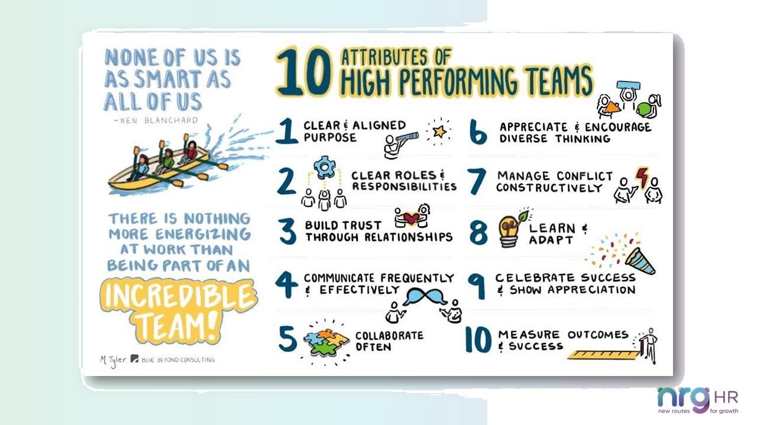
©2024 | AGILITY FOR ALL, LLC | PROPRIETARY & CONFIDENTIAL

Slide 19

Survey says…
86%
Around 63% of US Companies find it harder to retain than to hire
69%
69% of employees would work harder if they received more recognition
86%
Attracting high caliber employees leads to 33% revenue increase
86%
86%
Highly engaged employees lead to a 202% increase in performance
86% of job seekers avoid companies with a bad reputation
86%
86%
Team Leaders have the highest impact on company culture
Source: Team Stage 2022
Company culture is an important factor for 46% of job seekers

Slide 20
The results
©2024 | AGILITY FOR ALL, LLC | PROPRIETARY & CONFIDENTIAL

Slide 21

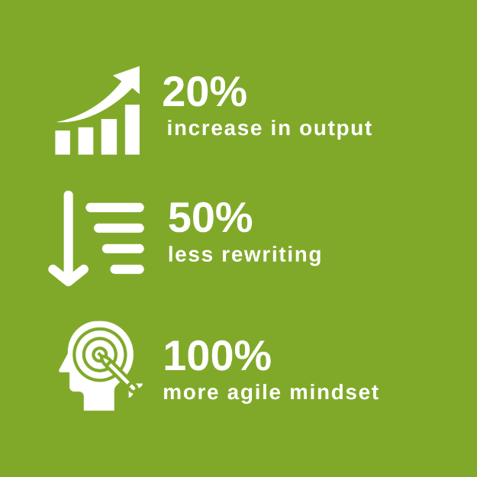
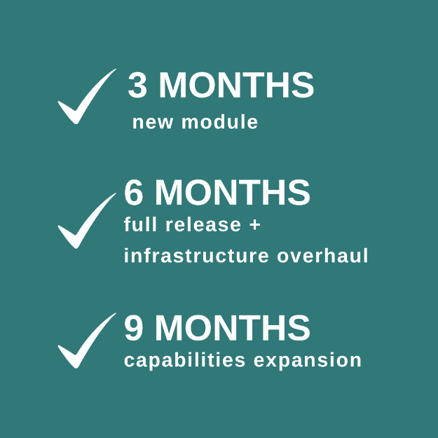
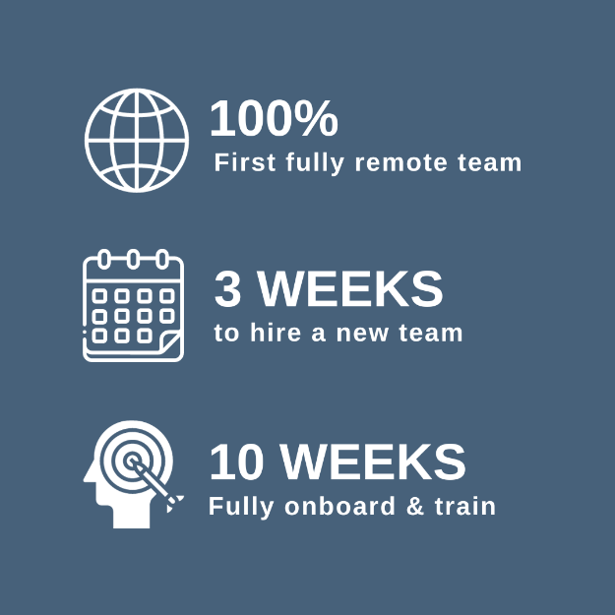
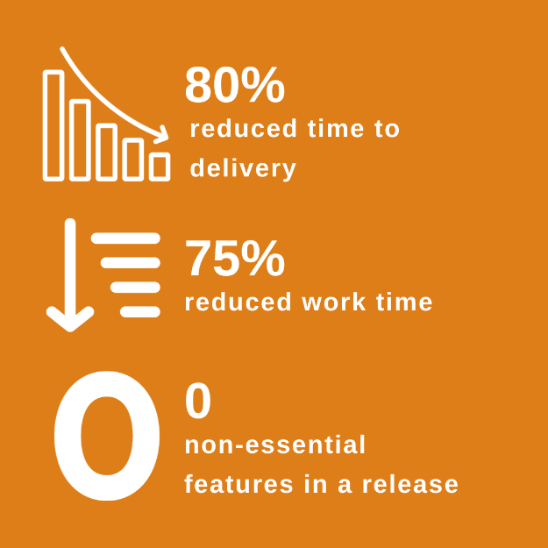
Tangible results – Value value valuE

Slide 22
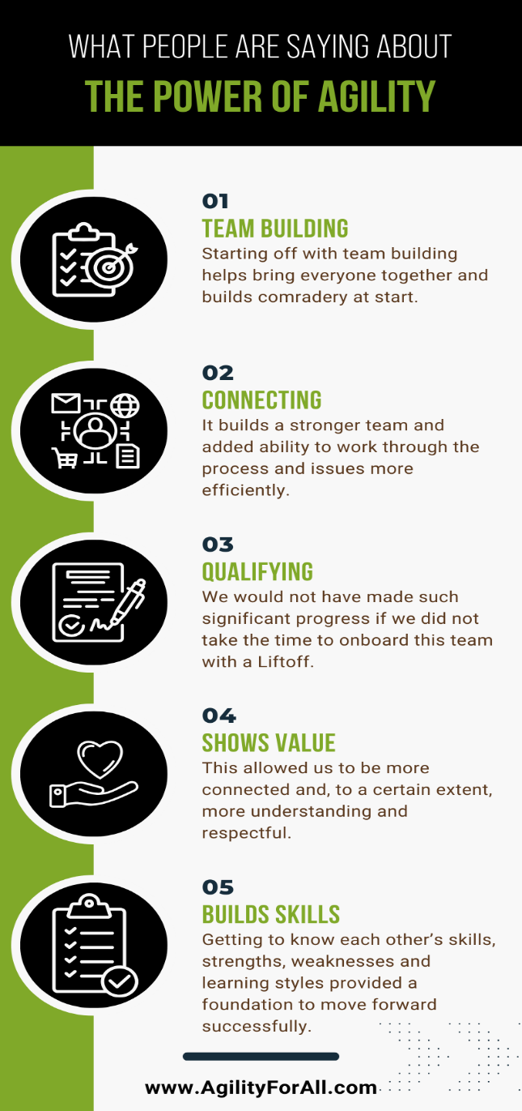

What people are saying about new ways of working

Slide 23
Agile adoption by the numbers the good…
Adoption on software teams increased from 37% in 2020 to 86% in 2021
(source: Digital.ai)
91% of organizations state agile adoption is a strategic priority
(source: KPMG)
70% of agile organizations say it helps them achieve faster time to market
(source: JCURV)
74% say improved results outweigh the effort to achieve results
(source: IPMA World and University of Applied Sciences)
Increased commercial/sales performance of 200+% when changing
(source: JCURV)
©2024 | AGILITY FOR ALL, LLC | PROPRIETARY & CONFIDENTIAL

Slide 24
…The bad and the ugly change is hard
74%
74% of organizations say that while they use frameworks, the culture doesn’t support a full adoption.
13%
62%
62% of top management believes it has no implications for them
17%
34%
72% of leaders believe they are effective, but their employees disagree (34%)
Only 13% stated that management fully supports agility and 38% said they get NO support
Only 17% of respondents truly feel empowered by their leaders
Source: KPMG and JCURV
©2024 | AGILITY FOR ALL, LLC | PROPRIETARY & CONFIDENTIAL

Slide 25
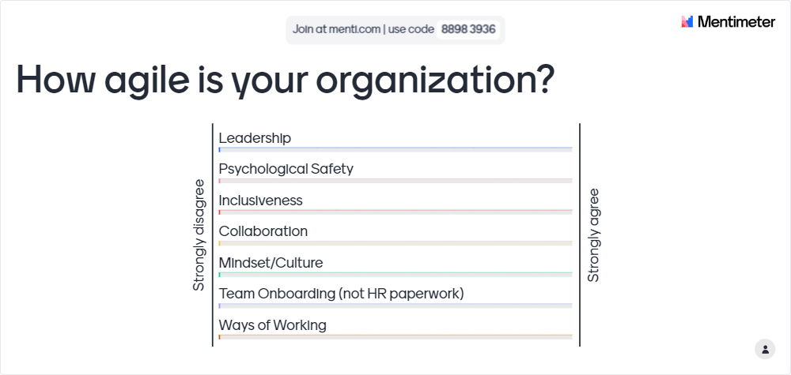
Rate your organization
©2024 | AGILITY FOR ALL, LLC | PROPRIETARY & CONFIDENTIAL

Slide 26





Free resources www.agilityforall.com/resources

